Slide 1
A Product In The Making
How to to Stop Worrying and Start Loving Product Strategy
theroadtlv.com

Slide 2
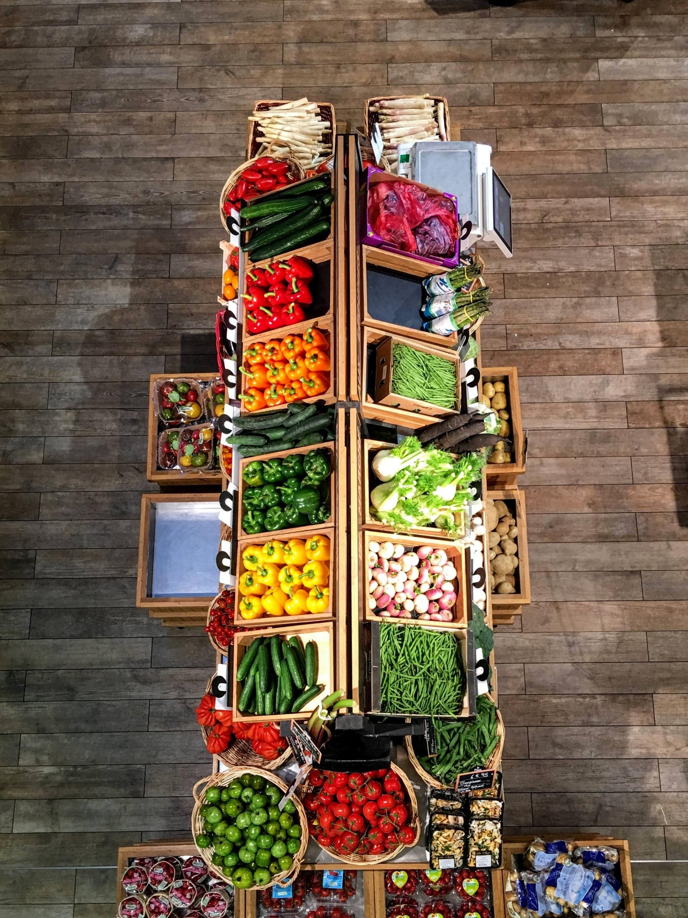
What’s In A Product?
A product is a place where…
Your technology meets your customers to answer their needs and wants

Slide 3
1st: KYC
Know Your Customer:
Who decides
Who pays
Who uses

Slide 4
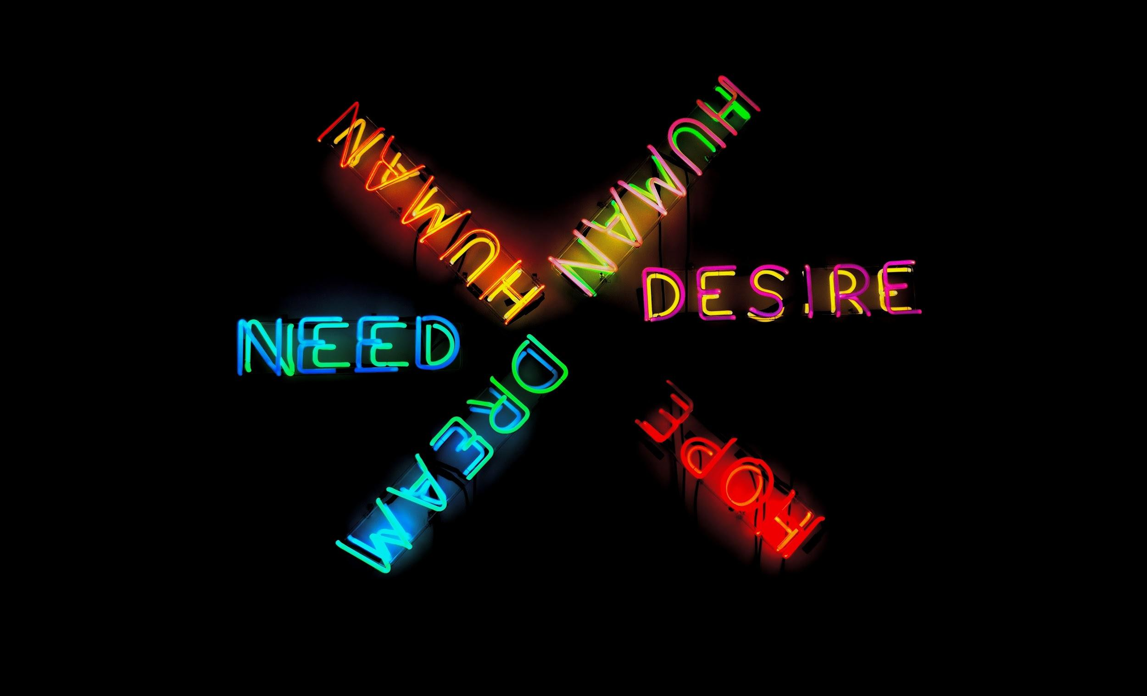
Start With The Need
What is the pain you are solving for?

Slide 5
Your Solution here ____________
How do you solve for customers’ pain?
3 f Words™
Functionality
Flow
Features

Slide 6
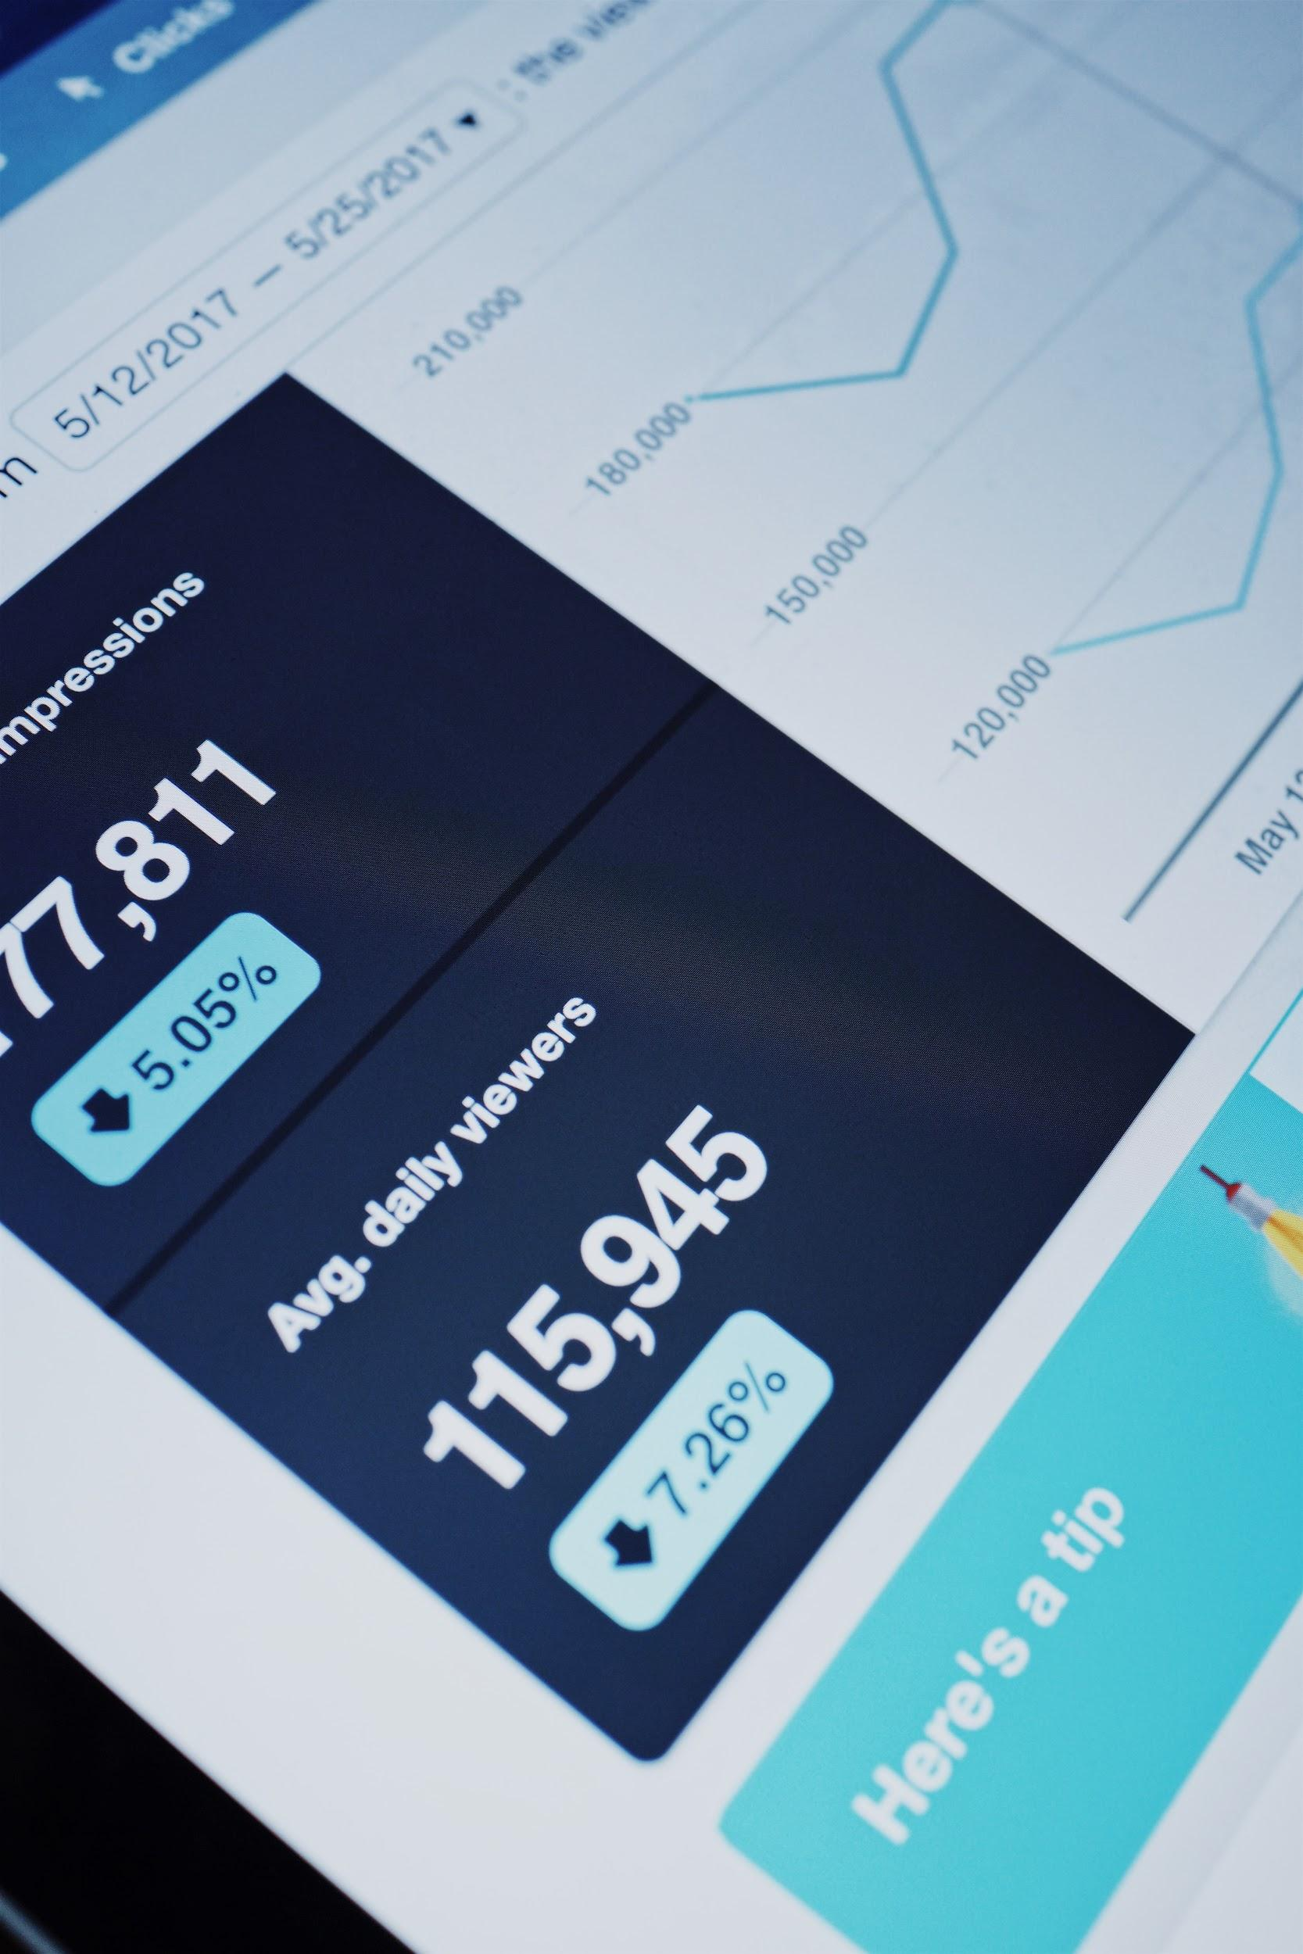
Model your Business
Build your business model into your product
Acquisition Costs
Revenue sources
LTV
Forecasts

Slide 7
Ways to your customer’s heart
Channels
Messages
“Branding Ready”

Slide 8
User Personas
Who are your users?
Is there more than one type?

Slide 9
Go With The Flow
Usage scenarios
Actions
Data Flow
States

Slide 10
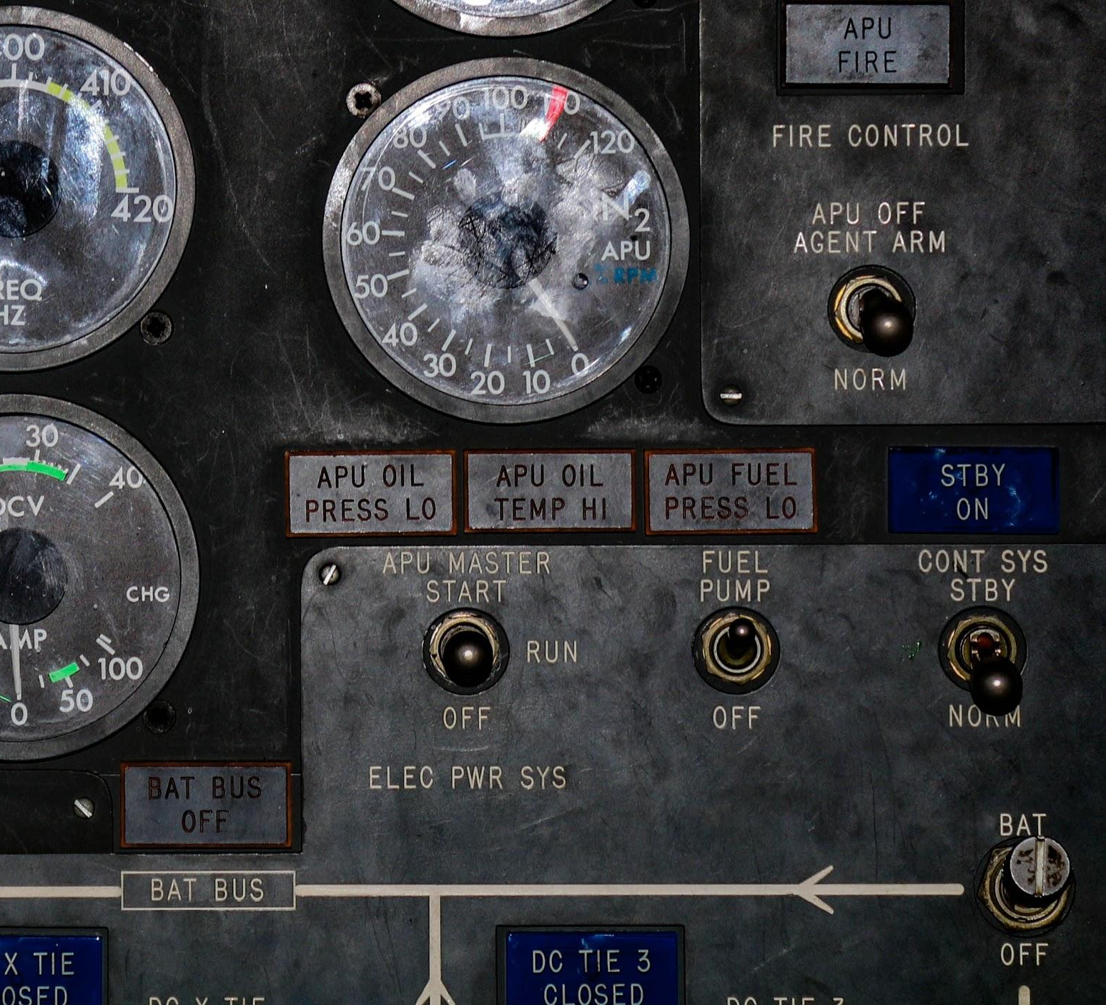
Model Your Data
Why measure?
What to measure
Time series
A/B testing
Conclusions
Repeat

Slide 11
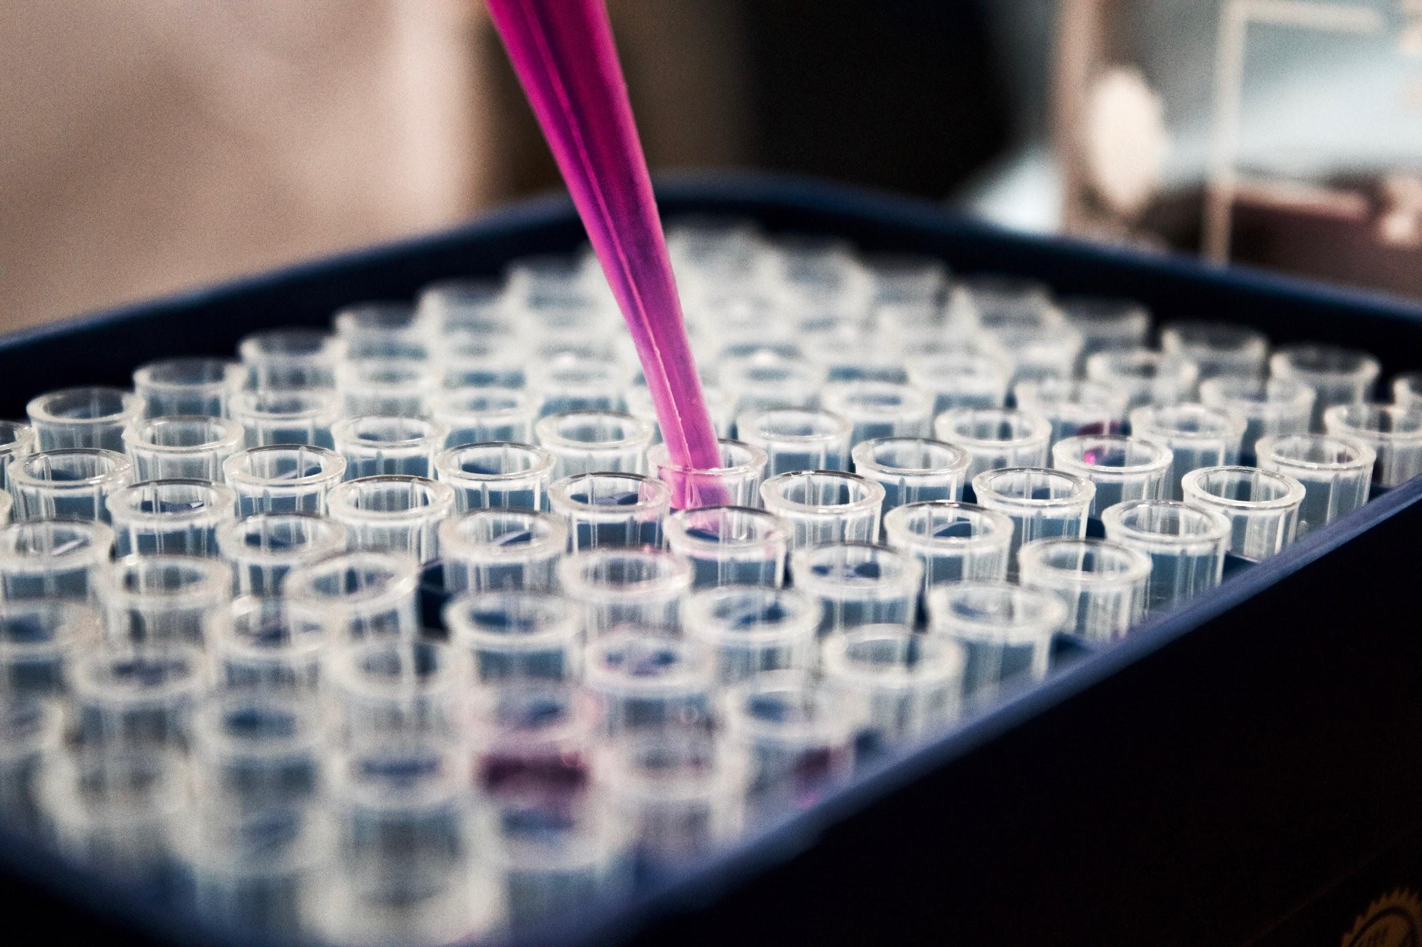
Iterate
Model
Visualize
Test
Repeat

Slide 12
MVP and the Future
Define your MVP
Build your roadmap

Slide 13
See It Coming To Life
Demo

Slide 14
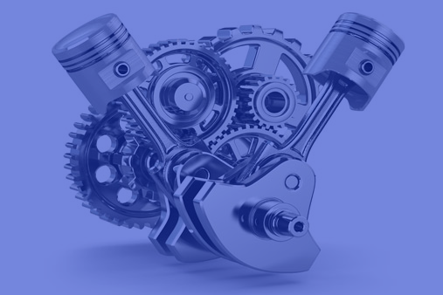
Build Your Product With TheRoad.
Email: yoel@theroadtlv.com
Web: https://theroadtlv.com
Phone: +972 54 6266221

